Slide 1
Ulysses Andrade-Meza
By Ulysses Andrade-Meza

Slide 2
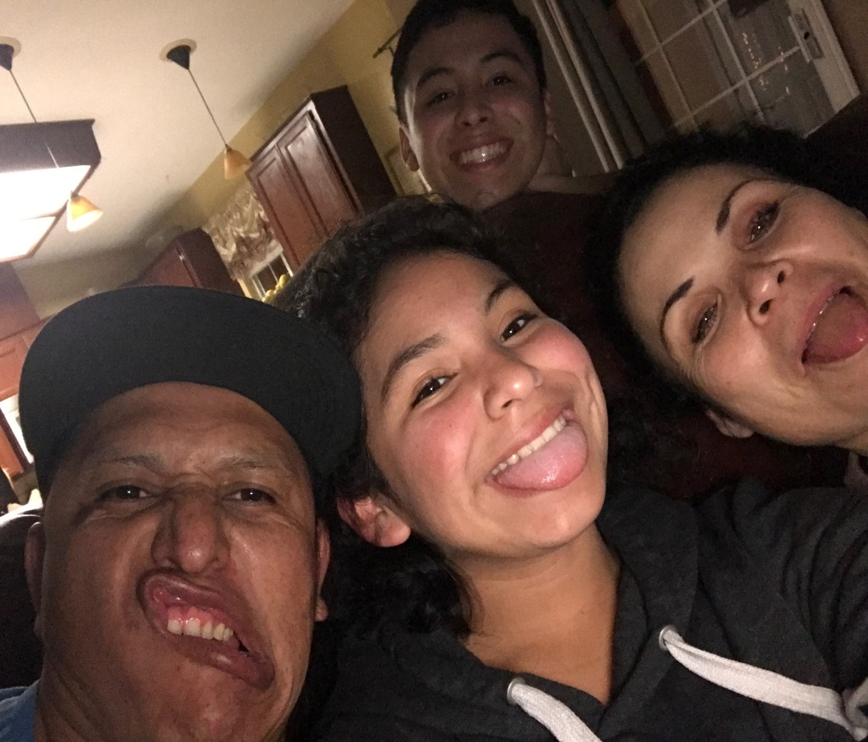
About Me
Father: Maurilio
Mother: Maria
Siblings: Gaspar & Estefania
Special talents I have is the love I have for working.
Personal challenge was
the loss of family members.

Slide 3
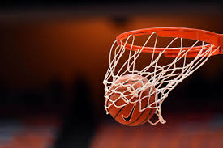
High School Experiences
Played football, basketball and golf
In PBS system I succeeded and went on my own pace.
As a student I need to be on myself to get things done.
High school has prepared me to live on my own in the real world.

Slide 4
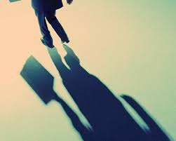
Job Shadow
Chose personal trainer
Connects to my career path
All day is exercising
Memorable thing is encouraging people
Do not see myself doing that

Slide 5
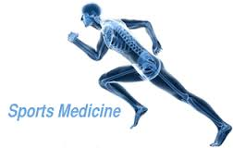
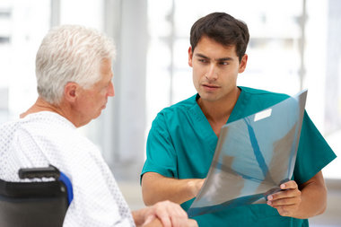
Pathway
Sports Medicine
Planning to become Register Nurse
Taught me to be careful with my health and be active.

Slide 6
Post-High School Plans
Planning to go to Sac State
Pursuing nursing
Like to help people
Family supports me

Slide 7
Leaving LHS
Love high school going to miss it
Teachers support and help
PBS system helped for future

